Slide 1
Birdsong Classification
A MidTerm Breakdown
By: Dean Cochran

Slide 2
Mission
The goal of this project is to build a general audio classifier capable of recognising different sounds.
The Sounds will be ambient noises from an urban environment, and then, a specific kind of sound - birdsong.
Eventually, the goal is to create a system that can be given a previously unheard recording of a bird singing and determine its species.

Slide 3
Purpose
● Diversity - Many people can readily recognise bird calls, but only after they’ve learned the characteristic of each species.
● Experience - I want to work with DSP (Digital Signal Processing) after college and this project serves as a way for me to be introduced into the field

Slide 4
Big Picture
If this sounds like Shazam for Birds, you’re thinking in the right direction. However, Songs have no variation.
What allows music identification services to recognise tracks is that they can compare acoustic fingerprints.
But there’s too much variation in birdsong for this approach.

Slide 5
Data
The Urban Sound 8K dataset - a collection of 8732 short clips covering 10 different sounds from urban environments
This set doesn’t contain any samples of birdsongs. However, I chose it because the sounds would enable me to explore the process of extracting features from raw audio.

Slide 6
The Problem with the Data
The input format will be the digital waveforms, just as would be recorded by a microphone, stored as WAV files. From this input, we’ll need to extract features. But sound recordings are not spreadsheets, with their data neatly organised into rows and columns of known significance.

Slide 7
The Problem with the Data cont.
The challenge then, is to find measurable properties that differ in recordings and are alike.
The feature extraction makes this problem an applicable for deep learning, which is capable of automated feature learning.

Slide 8
Data Exploration
Most of the samples are stereo recordings, sampled at 48000 hertz. The librosa library converts the samples to a single (mono) channel, and down-samples each to 22050 hz, which seems to be considered good for audio analysis.
Once in memory, the audio files are stored as a 1-dimensional numpy array, representing a time series.

Slide 9
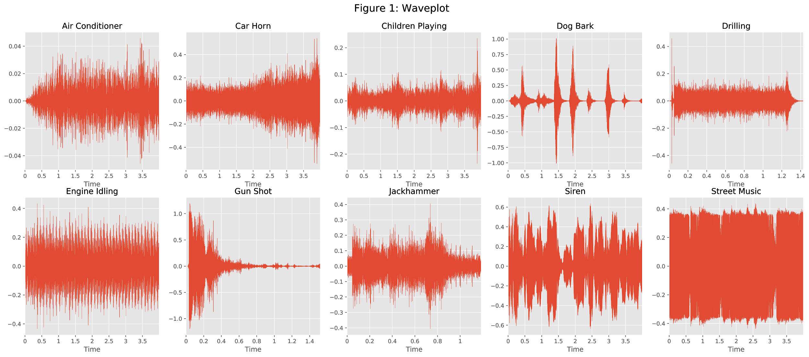
Visuals
A common visualisation for audio recordings is the waveform plot, which depicts the amplitude. Here are the waveforms for a randomly chosen example of each of the dataset’s 10 classes:
Notes:
In these plots, time is on the horizontal axis and amplitude on the vertical. We can see that some of the samples, like a dog barking, have a shape that is distinctively different from the others, which our classifier might be able to utilise to distinguish between them. Others like air-conditioning and engine idling are superficially more similar, and might be more difficult to tell apart - even for a human listener.

Slide 10
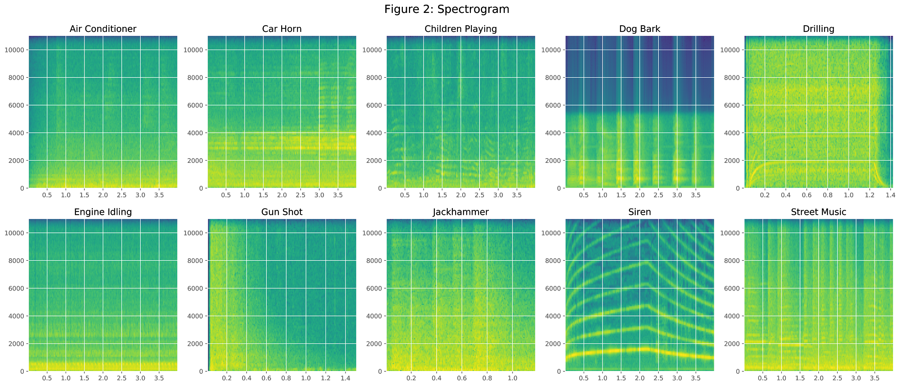
Visuals
Matplotlib provides an alternative visualisation method called spectrogram that calculates and plots the different intensities of the frequency spectrum. This creates a different depiction of each sound:
Notes:
These plots illustrate the complexity of the data we need to process. In typical supervised learning projects, every example in the training set has the same features, providing comparable values. But this is not the case with media such as audio or images, because any two files will not contain a pair of values that are semantically equivalent.
Consequently, in audio processing we can not consider each data value in isolation, and can not determine what is signal and what is noise merely by looking at the quantiles of a frequency distribution. Instead, the salient information is the patterns of values, spread over wide regions of the recording. This means we must consider how the signal changes over time, and what patterns can be identified. How this can be achieved will be discussed next.

Slide 11
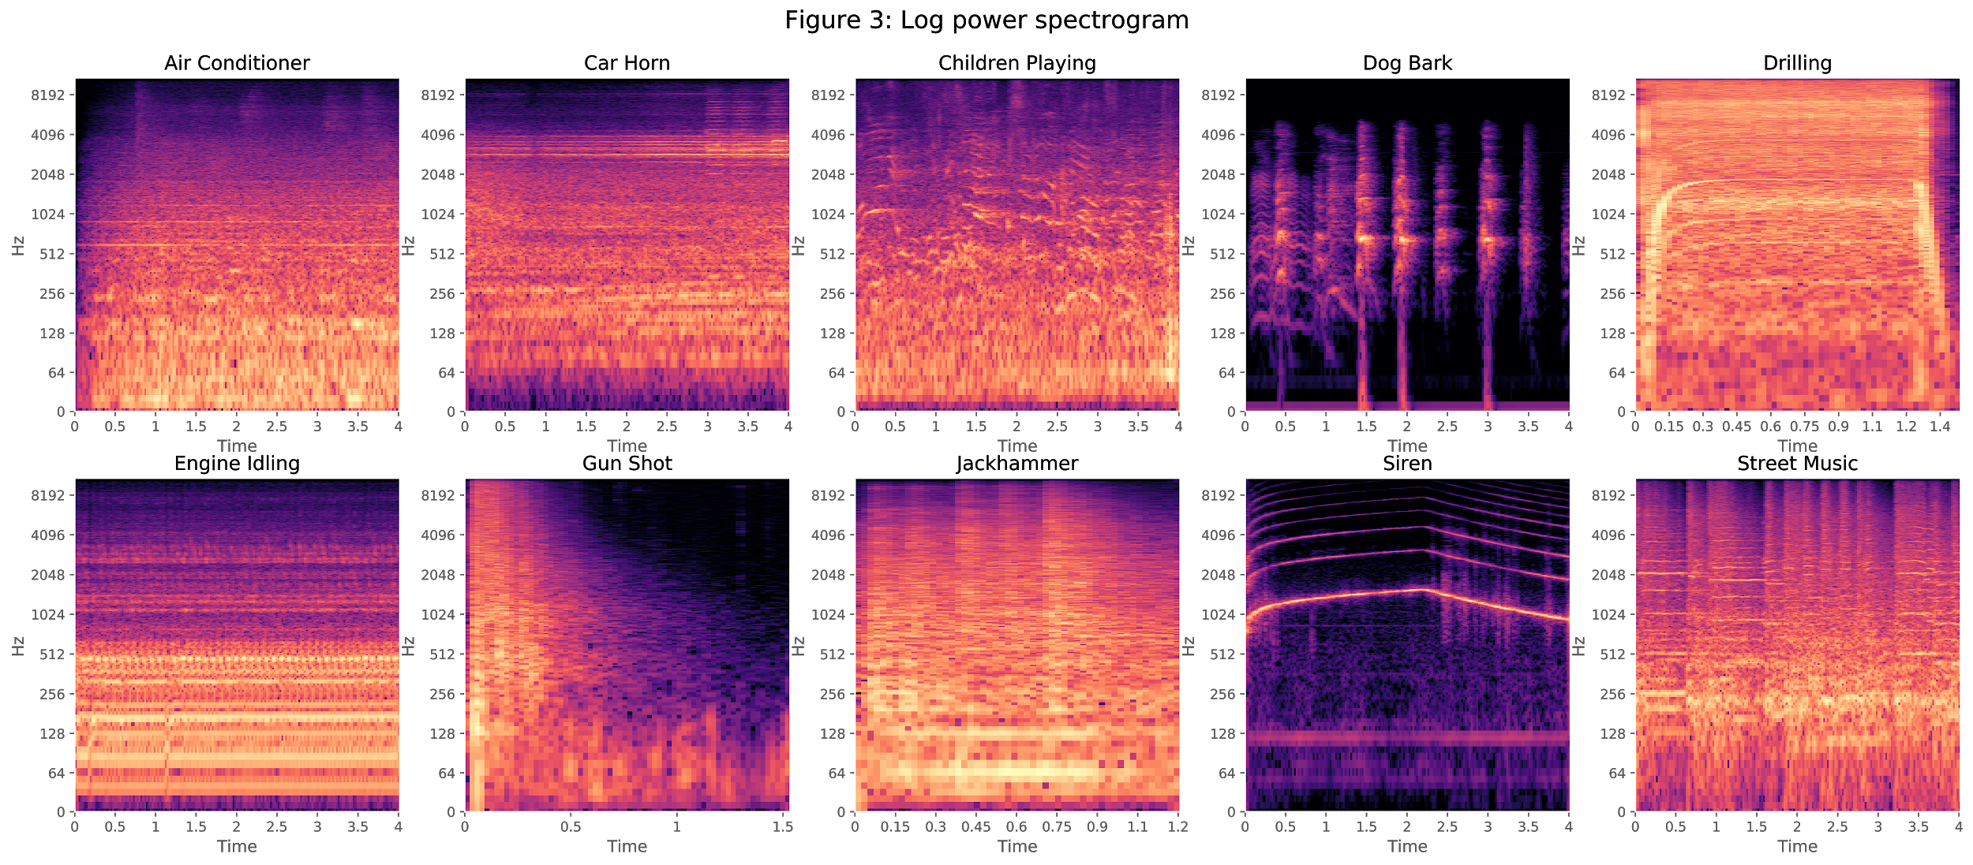

Slide 12
Data Pre-Processing
Each second of audio consists of 22050 data values. The convention for neural networks is to have one input node per feature, so a 2 second sample would require 44100 input nodes - far too many to run on a laptop. What’s needed is some means of dimensionality reduction.

Slide 13
Data Pre-Processing
After doing some research I found some of the feature extraction methods provided by the Python librosa library.
The idea is to reduce the tens of thousands of data points in each file into a much smaller set of features of fixed number.

Slide 14
Data Pre-Processing
The 5 feature extractions involved were:
● Mel-frequency cepstral coefficients
● Mel-scaled power spectrogram
● Chromagram of a short-time Fourier transform
● Octave-based spectral contrast
● Tonnetz

Slide 15
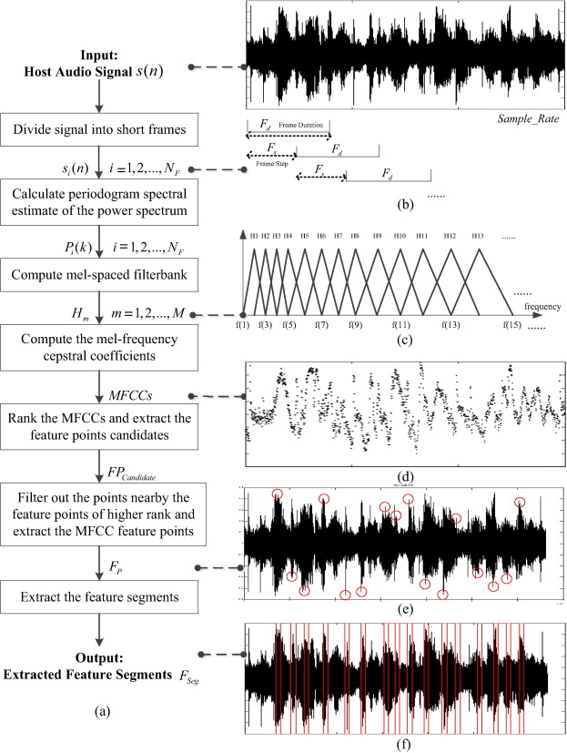
Mel-frequency cepstral coefficients
● The coefficients that collectively make up the short-term power spectrum of a sound
This is what MFCC refers to...

Slide 16
Mel-scale power spectrogram
● The Mel Scale is used to provide greater resolution for more informative (lower) frequencies

Slide 17
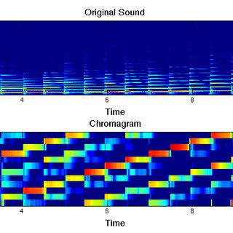
Chromagram of a Fourier Transform
● Projects into bins representing the 12 distinct semitones (or chroma) of the musical octave

Slide 18
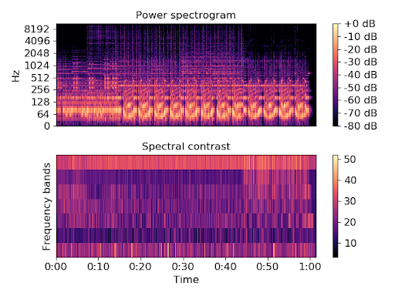
Octave-based spectral contrast
● Distributions of sound energy over octave frequencies

Slide 19
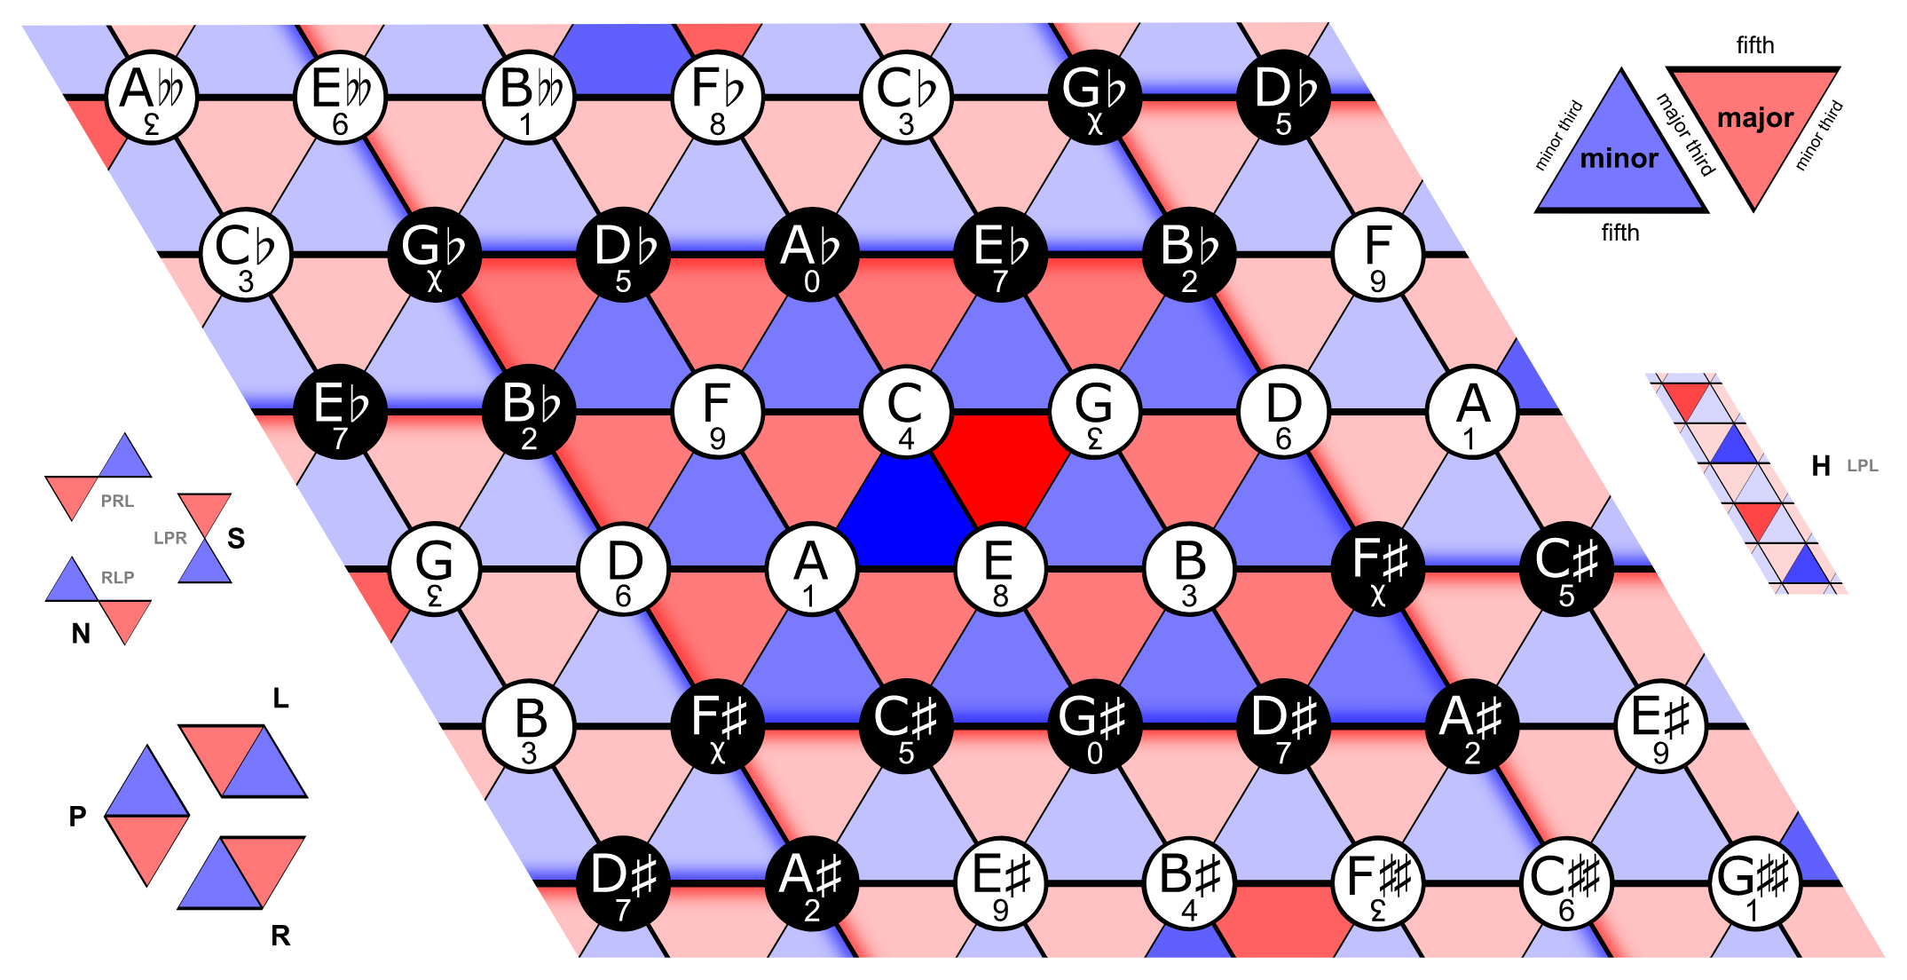
Tonnetz
● In musical tuning and harmony, the Tonnetz is a conceptual lattice diagram representing tonal space first described by Leonhard Euler in 1739.
It estimates tonal centroids as coordinates in a six-dimensional interval space.

Slide 20
Data Pre-Processing
The results of these 5 extractions are concatenated to give a consistent feature vector of 193 values for every audio clip processed.
Numpy’s save feature to export the extracted features to files allows me to reload the data when I need it later. This way I won’t have to process 9000 wav files every time I open the project.

Slide 21
Next Steps
Finding bird calls isn’t as necessary to me as classifying audio
Do I change the focus of my project
Can I find more data?

